Slide 1
Computer Graphics labs
Lab 0 - Introduction to Computer Graphics

Slide 2
Teaching Assistants
Yahia Zakaria
Email: yahiazakaria13@gmail.com
Alternative Email: yzetman@eng.cu.edu.eg (checked less regularly)
Office Hours:
Tuesday 12-2

Slide 3



Computer Graphics
In Games.
In Movies.
In CAD (Computer-aided design).

Slide 4
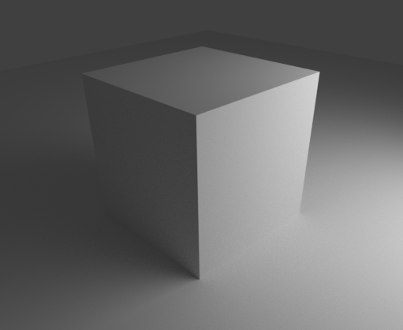
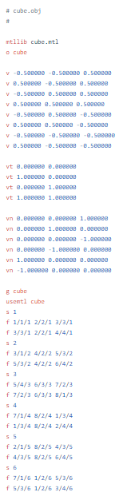
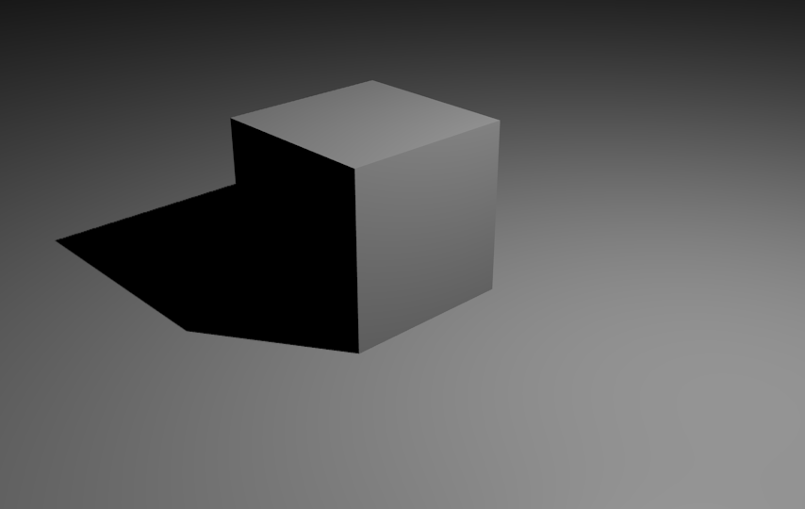
Notes:
Graphics usually aims to generate images that humans can comprehend.
On the left is a cube data in “.OBJ” format.
Upper example is created using Path-tracing (a relative of Ray-tracing) on Blender Cycles.
Lower Example is created using a rasterization-based renderer.

Slide 5



Graphics Engineer ≠ Game Developer
A game developer could use an Engine to produce a game with no knowledge about graphics.

Slide 6
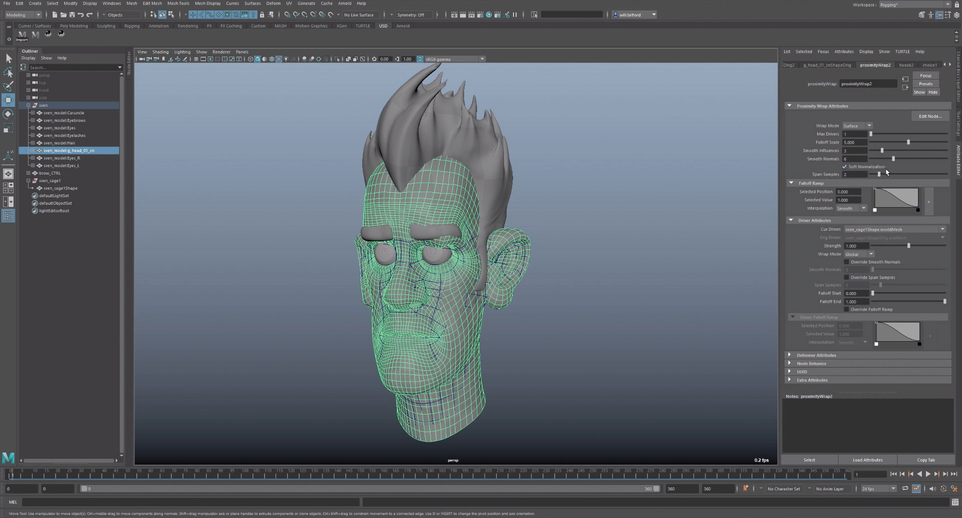
Graphics Engineer ≠ Game Developer
A graphics engineer creates different types of applications like:
Game Engines.
Rendering Softwares for animation movies.
Medical Applications.
… etc
Maya

Slide 7
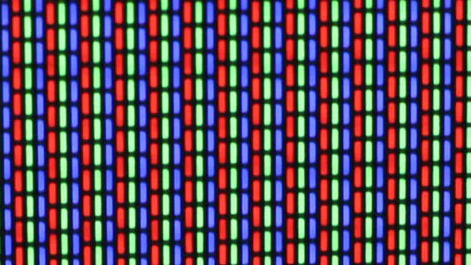
Why Graphics Processing Units GPUs?
Some applications are inherently parallel.
Like drawing pixels on the screen.

Slide 8
CPU vs GPU
CPU
CPU executes operations sequentially. A CPU will draw the screen pixel by pixel.

Slide 9
CPU vs GPU
GPU
GPU executes operations in parallel. A GPU could draw the screen at once (Theoretically).

Slide 10
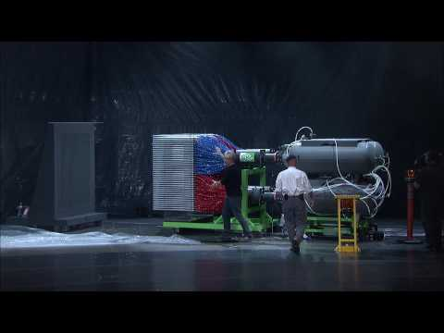

Slide 11
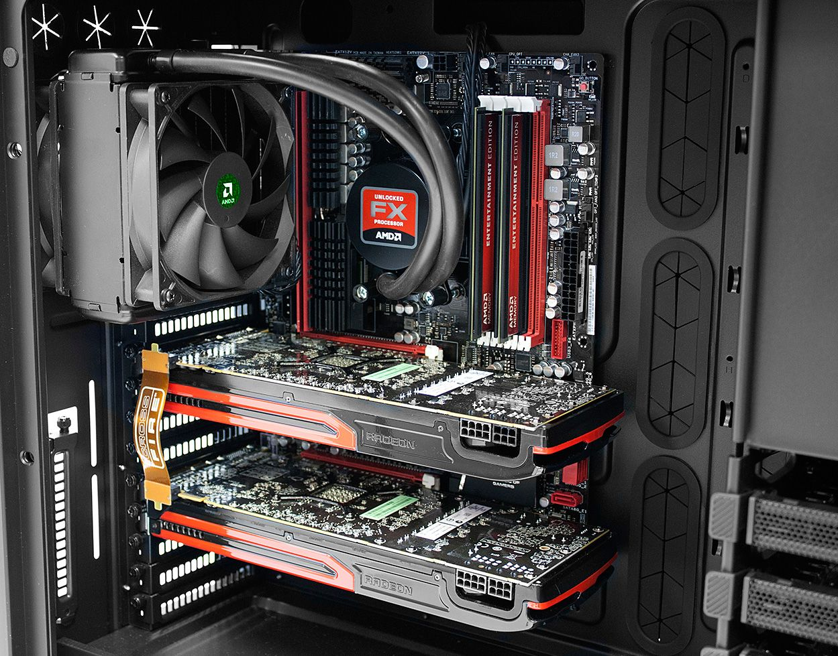
Notes:
Where is the CPU? And Where is the GPU?
Image Credit: Asus

Slide 12
But How can we talk to the GPU?
Graphics Applications
API
Driver
GPU
CAD, Games, Visualization, etc
OpenGL, DirectX, Vulkan, WebGL, Metal, etc
Released by the manufacturer
Graphics Processing Unit (AMD, Nvidia, Intel, PowerVR, etc)
Notes:
If our C++ code runs on the CPU, how can we run code on the GPU?
OpenGL is mostly implemented in the Driver by the vendor and the API connects our application to the driver which in turn controls the GPU.

Slide 13








Released in 1995
Released in 1992
Released in 2003
Released in 2011
Released in 2016
Released in 2015
Released in 2014
Not Released Yet
Notes:
OpenGL is the oldest API that is still popular till today and used in many modern applications. It is also expected to stay in demand for many years in the future.
It is also the base for OpenGL ES (for embedded systems such as smartphones) and WebGL (for web) which share an almost identical API.

Slide 14


This course
We will start by exploring openGL with C++.
And explore some rendering examples and use cases through the labs.
Note: OpenGL is a C-API which contains only functions and constants. We will use C++ for convenience and to use helper libraries written in C++.

Slide 15
Why OpenGL?
Ease of use.
Cross platform:
Windows
Linux
Mac (It was deprecated by Apple in 2018).
Up-to-date with modern gpu features.

Slide 16
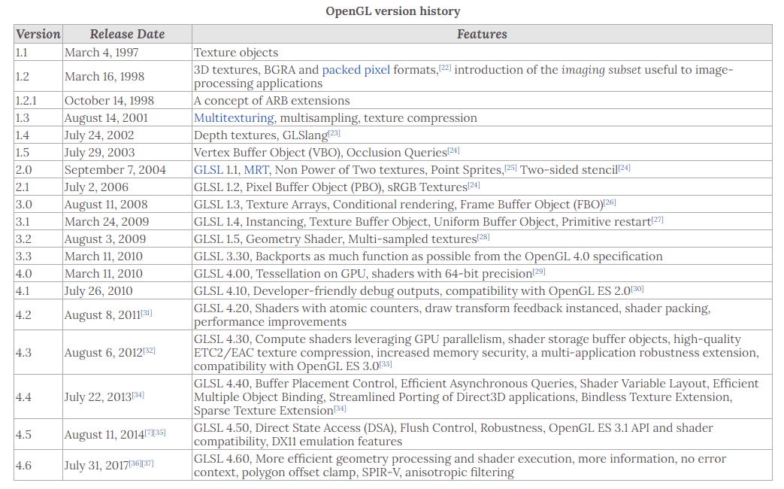
Notes:
Source: https://en.wikipedia.org/wiki/OpenGL
We will use OpenGL 3.3 since:
1- It is follows the modern OpenGL standards and removes all the legacy functions from the old fixed-pipeline days.
2- It is old enough that it is supported by almost every device out there.

Slide 17
Summary
OpenGL is a cross-language, cross-platform application programming interface (API) for rendering 2D and 3D vector graphics.
The API is typically used to interact with a graphics processing unit (GPU), to achieve hardware-accelerated rendering.

Slide 18
TOOLS WE NEED

Slide 19

CMake
CMake is a cross-platform free and open-source software tool for managing the build process of software using a compiler-independent method.
Link: https://cmake.org/
Version: 3.17+

Slide 20




Visual Studio .sln
MSVC
C++ Code Files
Makefile
Executable
CMake
CMakeLists.txt
Or Whatever...
Clang
Notes:
CMake doesn’t compile C++ code. It just prepares the code to be compiled by a compiler of your choice.
CMakeList.txt describes which code files should be compiled to build each library or executable, how to link the needed libraries, what compiler features you need, etc.
For example, CMake can turn the code files and CMakeLists to a visual studio solution then compile it via Microsoft Visual C++ Compiler.

Slide 21
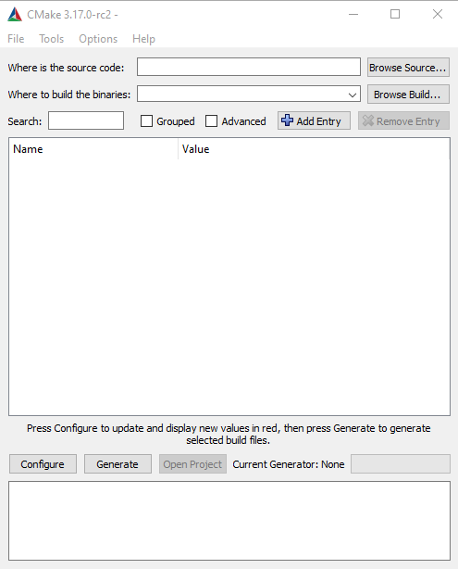
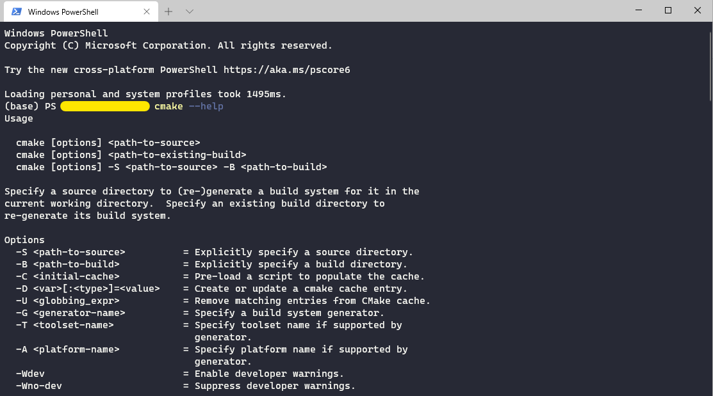
Using CMake: Method 1 - Directly (Unpreferred)
OR
Notes:
You can either use cmake from the terminal using the “cmake” command.
Or you can use the cmake-gui

Slide 22
Using CMake: Method 2 - Via an IDE
CLion (Student/Teacher edition is free).
Visual Studio 2017+ (2019 preferred) [windows only] with CMake support installed.
Visual Studio Code with the following extensions:
C/C++ by Microsoft
CMake by twxs
CMake Tools by Microsoft
QtCreator.

Slide 23
Which Compilers can we use?
Basically any compiler with C++17 support. This includes:
MSVC 19.15 (Comes with Visual Studio 2017 15.8). Newer versions are preferred.
Note: For Windows only. Can be found on https://visualstudio.microsoft.com/
GCC 10+
For windows, you can find it on WinLibs.com
For linux, it can be installed using the apt-get command.
Clang 5+
Can be installed as part of LLVM or alongside GCC from WinLibs.com

Slide 24
What else do we need?
All the needed libraries will be supplied with lab examples.
Make sure that your gpu driver is up to date.

Slide 25
Optional (Recommended) Tools
An extension for the GLSL language:
Visual Studio: GLSL language integration by Daniel Scherzer.
Visual Studio Code: Shader languages support for VS Code by slevesque.
CLion: GLSL Support plugin.
RenderDoc for debugging OpenGL state and api calls.
You can find other debugging tools on: https://www.khronos.org/opengl/wiki/Debugging_Tools

Slide 26
CMake Helping Material
CMake Projects in Visual Studio
CMake Tools for Visual Studio Code
CMake Projects in CLion
CMake Projects in QtCreator
CMake Tutorial

Slide 27
Game engine
Then we will implement what we learned in a simple game-engine and create a game with it.

Slide 28
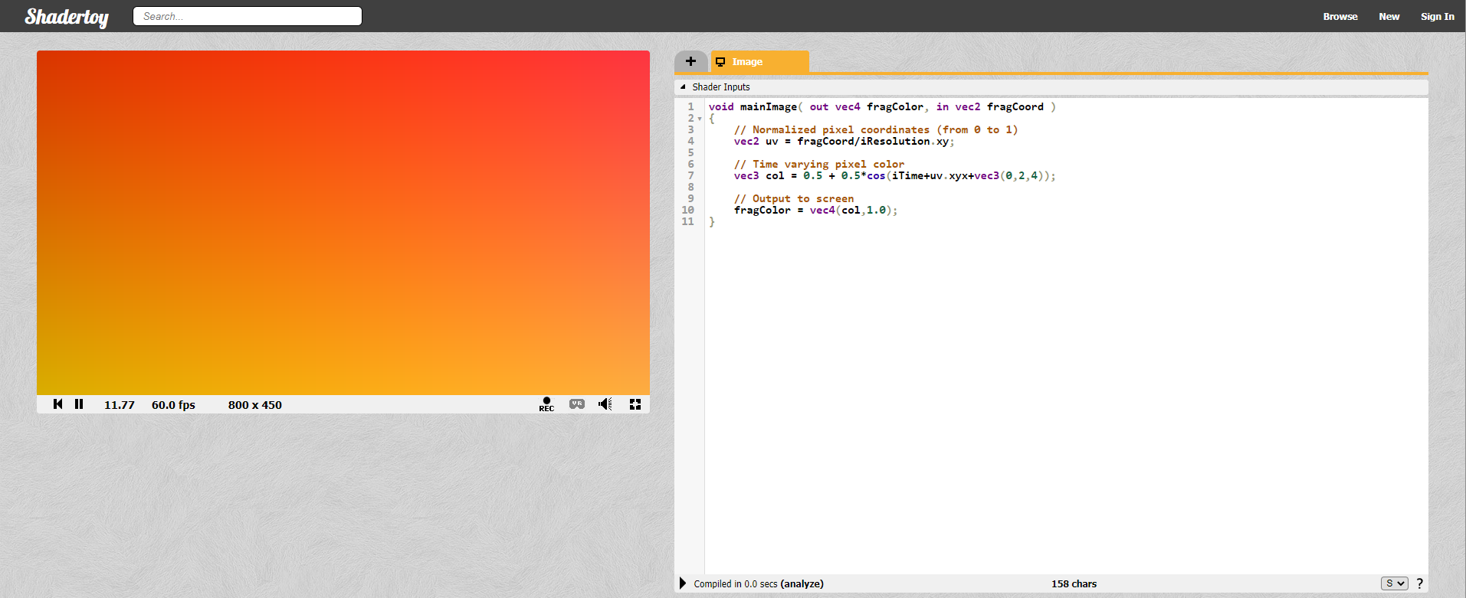
GPUs and drawing
Shaders are simple programs that describe the traits of either a vertex or a pixel.
Vertex shaders describe the attributes (position, texture coordinates, colors, etc.) of a vertex, while fragment shaders describe the traits (color, z-depth and alpha value) of a pixel (or a pixel fragment to be more precise).
Using fragment shader to color the screen.

Slide 29
Shadertoy example...
Notes:
//Rectangle Example
void mainImage( out vec4 fragColor, in vec2 fragCoord )
{
vec2 rectcoord = abs(fragCoord - iResolution.xy * 0.5);
if(all(lessThan(rectcoord, vec2(100.0)))){
fragColor = vec4(1.0, 0.0, 0.0, 1.0);
} else {
fragColor = vec4(0.0, 0.0, 0.0, 1.0);
}
}
//Circle Example
void mainImage( out vec4 fragColor, in vec2 fragCoord )
{
float dist = length(fragCoord - iResolution.xy * 0.5);
if(dist < 100.0){
fragColor = vec4(1.0, 0.0, 0.0, 1.0);
} else {
fragColor = vec4(0.0, 0.0, 0.0, 1.0);
}
}

Slide 30
Thank you

